Slide 1
Consuming Web Services with C#
IN712 OOSD 2017
Session 12.2
Notes:
There are an increasingly large number of internet-accessible services that provide data via RESTful http commands.
We have covered this process extensively in Mobile; you will also have seen it in Web 3.
So we are going to move rapidly over the basics, and then turn our attention to the syntactic particulars in C#
If any of you who aren’t in Mobile want to discuss the conceptual material further, or wish to be directed to more resources, please let me know.

Slide 2
Making a RESTful request
http://urlbase?key₁=value₁&key₂=value₂&...&key_{n}=value_{n}
http://universities.hipolabs.com/search?country=New Zealand
Notes:
An HTTP GET call
Base url, question mark and then a series of key=value pairs, separated with ampersands

Slide 3
Data Returned
[{"alpha_two_code": "NZ", "name": "University of Auckland", "country": "New Zealand", "web_page": "http://www.auckland.ac.nz/", "domain": "auckland.ac.nz"}, {"alpha_two_code": "NZ", "name": "Auckland University of Technology", "country": "New Zealand", "web_page": "http://www.aut.ac.nz/", "domain": "aut.ac.nz"}, {"alpha_two_code": "NZ", "name": "University of Canterbury", "country": "New Zealand", "web_page": "http://www.canterbury.ac.nz/", "domain": "canterbury.ac.nz"}, {"alpha_two_code": "NZ", "name": "Christchurch Polytechnic Institute of Technology", "country": "New Zealand", "web_page": "http://www.cpit.ac.nz/", "domain": "cpit.ac.nz"}, {"alpha_two_code": "NZ", "name": "Lincoln University", "country": "New Zealand", "web_page": "http://www.lincoln.ac.nz/", "domain": "lincoln.ac.nz"}, {"alpha_two_code": "NZ", "name": "Massey University", "country": "New Zealand", "web_page": "http://www.massey.ac.nz/", "domain": "massey.ac.nz"}, {"alpha_two_code": "NZ", "name": "Open Polytechnic", "country": "New Zealand", "web_page": "http://www.openpolytechnic.ac.nz/", "domain": "openpolytechnic.ac.nz"}, {"alpha_two_code": "NZ", "name": "University of Otago", "country": "New Zealand", "web_page": "http://www.otago.ac.nz/", "domain": "otago.ac.nz"}, {"alpha_two_code": "NZ", "name": "Victoria University of Wellington", "country": "New Zealand", "web_page": "http://www.vuw.ac.nz/", "domain": "vuw.ac.nz"}, {"alpha_two_code": "NZ", "name": "University of Waikato", "country": "New Zealand", "web_page": "http://www.waikato.ac.nz/", "domain": "waikato.ac.nz"}]
Notes:
Modern web services return their as text, in XML and/or more commonly now, JSON
C# provides a choice of classes form managing both of these steps.
Today we will look at one option for each; you may wish to explore the various alternatives

Slide 4

Making a GET request
Notes:
Assume urlString contains a legal url that returns Json
This is your basic HttpClient call
Very easy
See the docs for things like adding authorisation information, checking the result, etc.

Slide 5
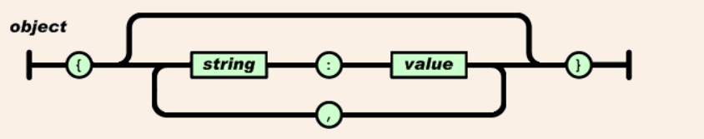
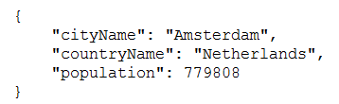
JSON – Formal Definitions
Notes:
You will recognise these from Mobile...
Just follow the paths
An object starts with a { and ends with a }
In between there are zero or more elements, separated by commas.
Each element is a string, followed by a :, followed by a value (we’ll see exactly what a value is in a moment)
Here is a simple JSON object. Three key-value pairs; each value a simple scalar string.
If you’ve ever made objects in JavaScript, you will recognise the syntax.
The indentation – and in fact, the line feeds – are irrelevant. That’s just for people. JSON parsers ignore that stuff.
We will see in a moment that the value can actually be quite complicated, allowing for nested structures, multiple structures, etc.

Slide 6
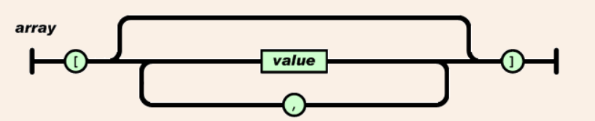

JSON – Formal Definitions
Notes:
An array starts with [ and ends with ]
In between is a comma-separated list of values
Here is a simple example, where the values are just strings.
As mentioned before, value can be lots of things.
Let’s look at the diagram for value...

Slide 7
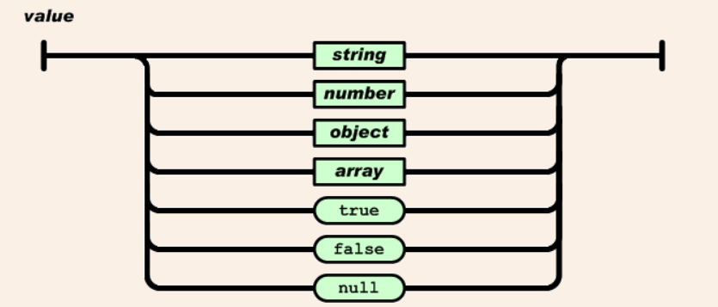
JSON – Formal Definitions
Notes:
So value can itself be an object or an array – the definition is recursive
So in an object, you can have a key-value pair where the value is itself a another object (it will start with {) or an array (it will start with [)
You can have arrays of objects
You can have objects that contains arrays of objects...
And so on.
Let’s look at a possible representation for our city data, adding in population values...

Slide 8
Dealing with JSON
[{"alpha_two_code": "NZ", "name": "University of Auckland", "country": "New Zealand", "web_page": "http://www.auckland.ac.nz/", "domain": "auckland.ac.nz"}, {"alpha_two_code": "NZ", "name": "Auckland University of Technology", "country": "New Zealand", "web_page": "http://www.aut.ac.nz/", "domain": "aut.ac.nz"}, {"alpha_two_code": "NZ", "name": "University of Canterbury", "country": "New Zealand", "web_page": "http://www.canterbury.ac.nz/", "domain": "canterbury.ac.nz"}, {"alpha_two_code": "NZ", "name": "Christchurch Polytechnic Institute of Technology", "country": "New Zealand", "web_page": "http://www.cpit.ac.nz/", "domain": "cpit.ac.nz"}, {"alpha_two_code": "NZ", "name": "Lincoln University", "country": "New Zealand", "web_page": "http://www.lincoln.ac.nz/", "domain": "lincoln.ac.nz"}, {"alpha_two_code": "NZ", "name": "Massey University", "country": "New Zealand", "web_page": "http://www.massey.ac.nz/", "domain": "massey.ac.nz"}, {"alpha_two_code": "NZ", "name": "Open Polytechnic", "country": "New Zealand", "web_page": "http://www.openpolytechnic.ac.nz/", "domain": "openpolytechnic.ac.nz"}, {"alpha_two_code": "NZ", "name": "University of Otago", "country": "New Zealand", "web_page": "http://www.otago.ac.nz/", "domain": "otago.ac.nz"}, {"alpha_two_code": "NZ", "name": "Victoria University of Wellington", "country": "New Zealand", "web_page": "http://www.vuw.ac.nz/", "domain": "vuw.ac.nz"}, {"alpha_two_code": "NZ", "name": "University of Waikato", "country": "New Zealand", "web_page": "http://www.waikato.ac.nz/", "domain": "waikato.ac.nz"}]
Notes:
The web service returns to us a big incomprehensible string, but if it is legal JSON there is a clear format.
You just can’t see it easily because white space has been removed
A JSON viewer will display it in a more human-friendly way...

Slide 9
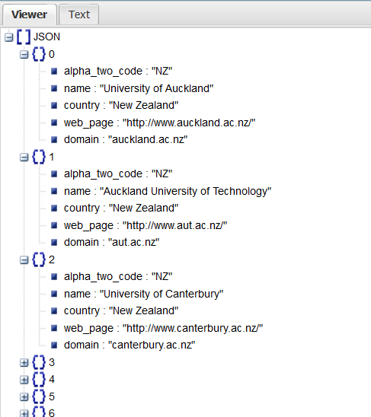
Dealing with JSON
Notes:
The root object is an array with key JSON
Each element in the array is an object
Each array element object has five key:value pairs as shown.
You could, if you had to, write a class that could take in JSON and parse it for you by hunting for [ and { and so on and following the rules.
Fortunately, there are a number of existing parsers already available for working with JSON in .NET
The most stable and popular is NewtonSoft.JSON

Slide 10
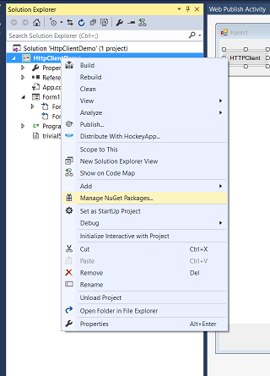
Json.NET
Notes:
NewtonSoft is a publically available library package that you can add to your .NET project using Visual Studio’s NuGet package manager, as shown

Slide 11
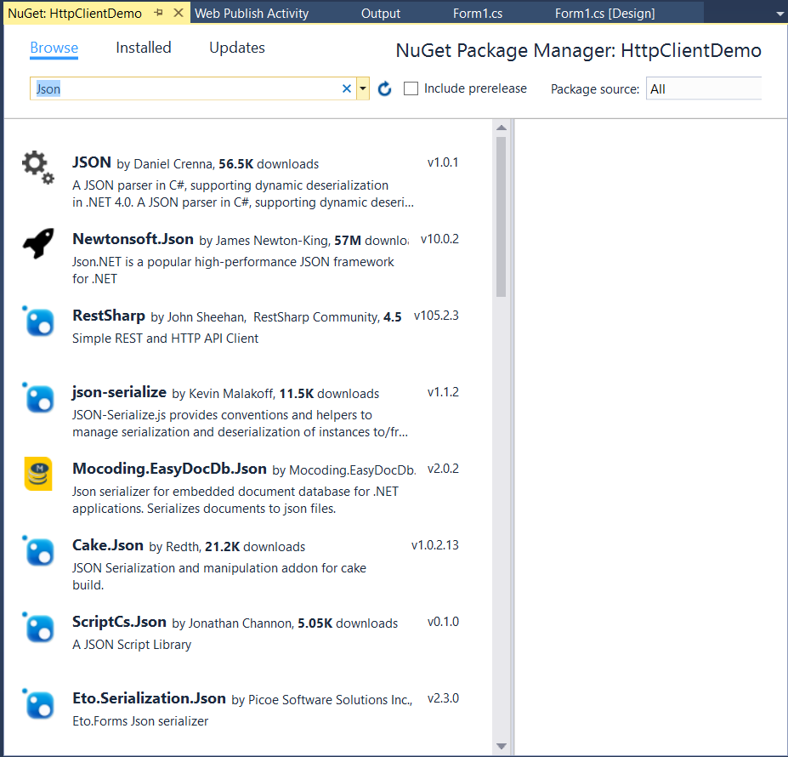
Json.NET
Notes:
In NuGet, click the Browse tab
Because NewtonSoft is so popular, it may just pop up. If not, search for it.

Slide 12
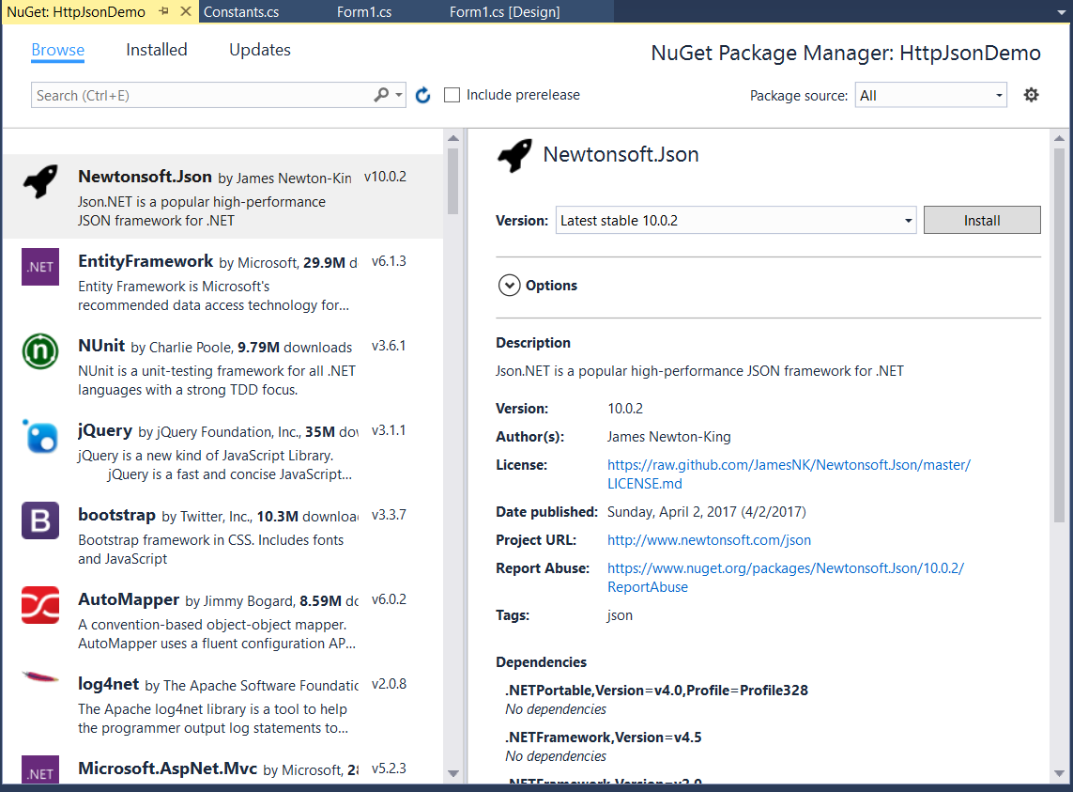
Json.NET
Notes:
...and install it.
Once installed you will be able to access the Newtonsoft classes by adding the appropriate using statement...

Slide 13
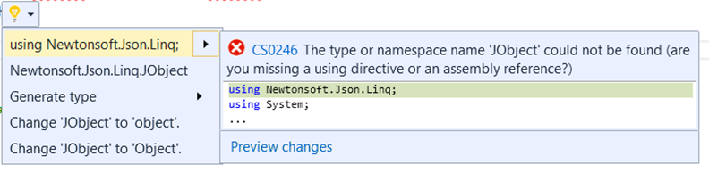
Json.NET
http://www.newtonsoft.com/json/help/html/Introduction.htm
Notes:
Documentation can be found here

Slide 14


Json.Net
To parse a string of raw JSON
To access a child object
To access a string value
Notes:
Primary commands

Slide 15
Json.Net
Fetching an array
Notes:
When you have a key:value pair whose value is an array, you want to grab out the whole array into an Ienumerable of Jobject for processing
Here is a common technique (see docs for alternatives)
This is, you will notice, LINQ.
Json.NET is designed to be used with LINQ, and you will see many examples in the documentation.

Slide 16
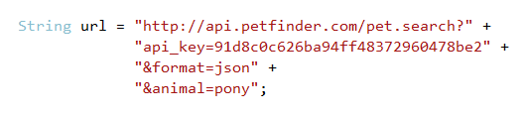
API Keys
Notes:
Most services require API keys, and give them away for registration
Unless the service seems really dodgy, there should be no problem with this.
You may wish to use an email account that you reserve for such things, though.

Slide 17
Practical
Build an application that allows a user to enter a country code, and then displays a description of the current weather in that country’s most populous city, and the name and population of that city.
Use ISO Alpha-3 Codes. Typing in is ok. http://www.nationsonline.org/oneworld/country_code_list.htm
Implement in ASP.NET MVC
Use the World database on bitdev (dynamically) to find the most populous city.
Use a REST API Web service (dynamically) to check the weather. Free services only.
Handle errors gracefully.
Allow the user to perform multiple searches without using the browser back button.
Notes:
Invest some time in this practical.
You will be using these techniques in your second assignment.

